Slide 1

Digital Portfolio
STUDENT NAME: B. Sandhiya REGISTER NO AND NMID: 222402542/asunm161222402542 DEPARTMENT: Computer science COLLEGE: COLLEGE/UNIVERSITY
Prince Shri Venkateshwara Arts& Science college/Madras
University
1

Slide 2

PROJECT TITLE
Digital portfolio using front End web Development
2

Slide 3



AGENDA
1.Problem Statement 2.Project Overview 3.End Users 4.Tools and Technologies 5.Portfolio design and Layout 6.Features and Functionality 7.Results and Screenshots 8. Conclusion 9.Github Link
3/21/2024 Annual Review
3

Slide 4


PROBLEM STATEMENT
Intoday's digital age, students needastructured way to
showcase their skills, projects, and achievements online. Traditional resumes and paper-based portfolios lack interactivity and real-time accessibility. A digital portfolio provides an engaging, organized, and professional platform for personal and academic representation.
4

Slide 5

PROJECT OVERVIEW
"This digitalportfolio showcases acurated collection of my
work, highlighting skills in design, development, and creative problem-solving. It includes projects across various domains, demonstrating technical proficiency and a strong sense of visual storytelling. The portfolio is designed for easy navigation and reflects my personal brand and growth."
5

Slide 6
WHO ARE THE END USERS?
1.Teachers/Instructors–Assess students' learning, progress, and reflections.
2.Students (Self-assessment) – Use it to reflect on their own growth.
3.Peers/Classmates – Review or provide feedback during collaborative or peer- assessment activities.
4.Parents/Guardians – View progress or understand the student’s learning journey.
5.Administrators – Evaluate the effectiveness of curriculum or teaching methods.
6

Slide 7

TOOLS AND TECHNIQUES
HTML-to structure the content(headings, text, images, links). CSS-to design and style the portfolio (colors, fonts, layout). JavaScript-to add interactivity(forms, animations, navigation).
7

Slide 8

POTFOLIO DESIGN AND LAYOUT
1.GRID— Organizes content in rows and columns for clean, balanced visuals.
2.Mansonry— Uses uneven grid layouts with variable item sizes, like Pinterest style.
3.SINGLE—PAGE(SPA)-All content on one scrolling page, often with smooth navigation links.
4.CAROUSEL— Displays items in a sliding or rotating frame, ideal for showcasing projects one at a time.
5.TILE— Uses uniform tiles or cards for each project/item, easy to scan quickly.
8

Slide 9
FEATURES AND FUNCTIONALITY
A digital portfolio is a curated collection of work and information presented digitally to showcase skills, experiences, and achievements. It's commonly used by students, professionals, artists, designers, developers, and freelancers. Below is a breakdown of the key features and functionalities you should consider including in a well-structured digital portfolio.

Slide 10
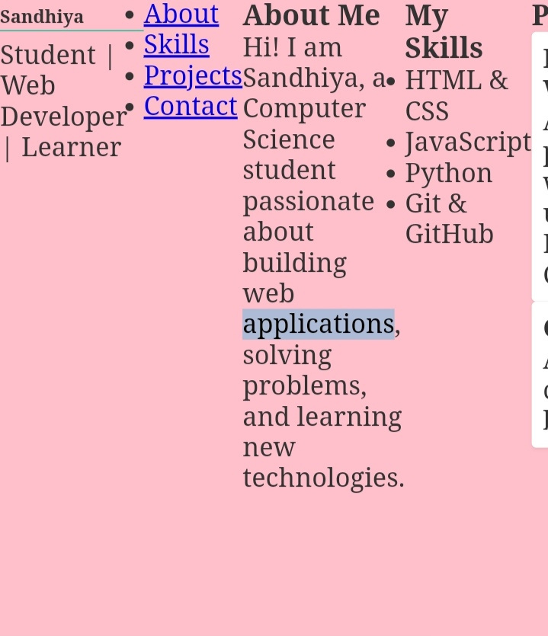

RESULTS AND SCREENSHOTS
3/21/2024 Annual Review
10

Slide 11
CONCLUSION
Each project presented here reflects not only my skills and technical abilities, but also my passion for continuous growth, creativity, and meaningful problem-solving. Whether through collaboration, innovation, or attention to detail, I strive to bring value to every opportunity.
11

Slide 12
Github link
https://13410cs2024-coder.github.io/TNSDC-FWD-DP/

